Slide 1
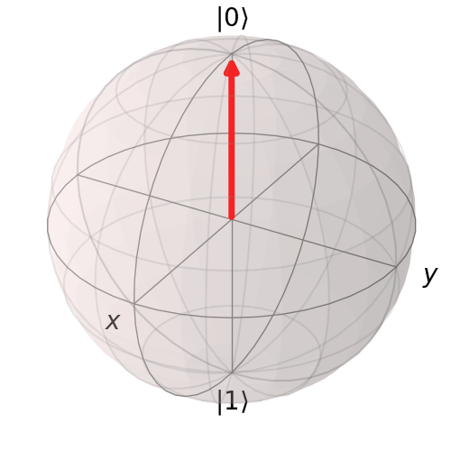

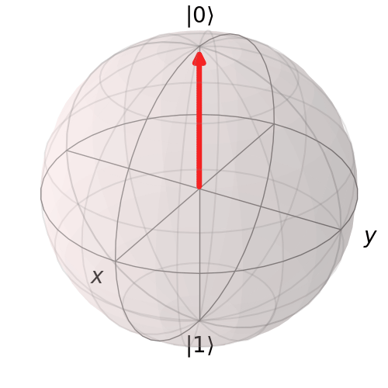
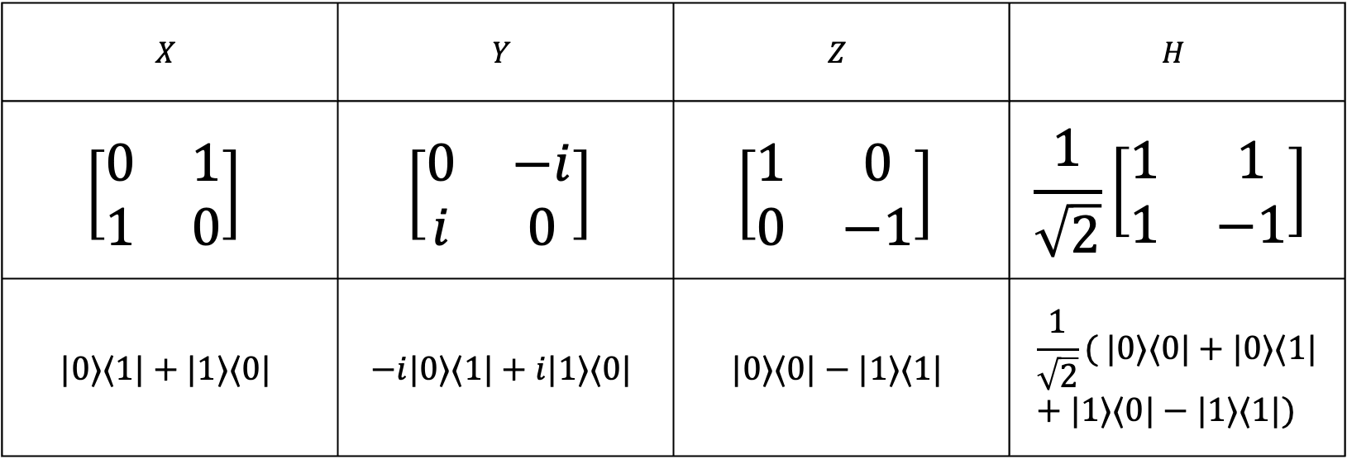
Single qubit gate
Notation
$$X$$ | $$Y$$ | $$Z$$ | $$H$$
$$\left[\begin{matrix}0 & 1 \\ 1 & 0\end{matrix}\right]$$ | $$\left[\begin{matrix}0 & −i \\ i & 0\end{matrix}\right]$$ | $$\left[\begin{matrix}1 & 0 \\ 0 & −1\end{matrix}\right]$$ | $$\frac{1}{\sqrt{2}}\left[\begin{matrix}1 & 1 \\ 1 & −1\end{matrix}\right]$$
$$|0⟩⟨1|+|1⟩⟨0|$$ | $$−i|0⟩⟨1|+i|1⟩⟨0|$$ | $$|0⟩⟨0|−|1⟩⟨1|$$ | $$\frac{1}{\sqrt{2}}( |0⟩⟨0|+|0⟩⟨1|+|1⟩⟨0|−|1⟩⟨1|)$$
Matrix form

Slide 2
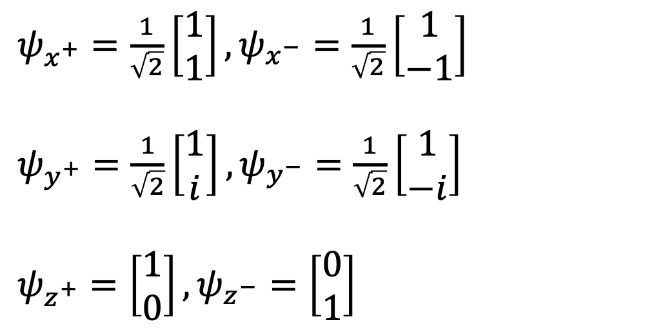
Single qubit gate: properties
All Pauli matrices have eigenvalues $±1$ and its eigenvectors (eigenstates):
$ψ_{x^{+}}=\frac{1}{\sqrt{2}}\left[\begin{matrix}1 \\ 1\end{matrix}\right],ψ_{x^{−}}=\frac{1}{\sqrt{2}}\left[\begin{matrix}1 \\ −1\end{matrix}\right]$
$ψ_{y^{+}}=\frac{1}{\sqrt{2}}\left[\begin{matrix}1 \\ i\end{matrix}\right],ψ_{y^{−}}=\frac{1}{\sqrt{2}}\left[\begin{matrix}1 \\ −i\end{matrix}\right]$
$ψ_{z^{+}}=\left[\begin{matrix}1 \\ 0\end{matrix}\right],ψ_{z^{−}}=\left[\begin{matrix}0 \\ 1\end{matrix}\right]$
Exercise: What are eigenstates of Identity matrix ($0^{th}$ Pauli matrix)?

Slide 3
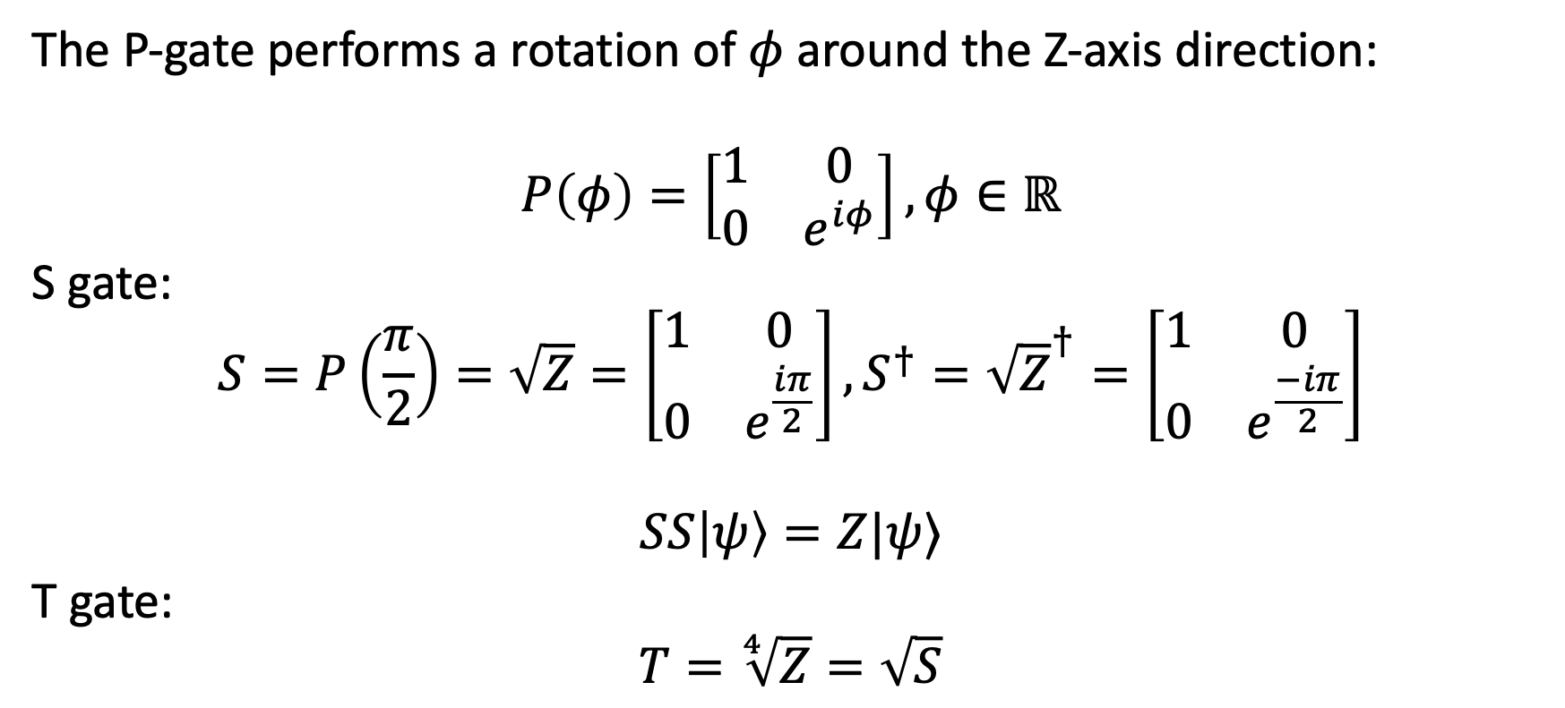
Single qubit gate: phase gate
The P-gate performs a rotation of $φ$ around the Z-axis direction:
$$P\left(φ\right)=\left[\begin{matrix}1 & 0 \\ 0 & e^{iφ}\end{matrix}\right],φ∈ℝ$$
S gate:
$$S=P\left(\frac{π}{2}\right)=\sqrt{Z}=\left[\begin{matrix}1 & 0 \\ 0 & e^{\frac{iπ}{2}}\end{matrix}\right], S^{†}={\sqrt{Z}}^{†}=\left[\begin{matrix}1 & 0 \\ 0 & e^{\frac{−iπ}{2}}\end{matrix}\right]$$
$$SS\left|ψ\right\rangle =Z|ψ⟩$$
T gate:
$$T=\sqrt[4]{Z}=\sqrt{S}$$
Parameter

Slide 4
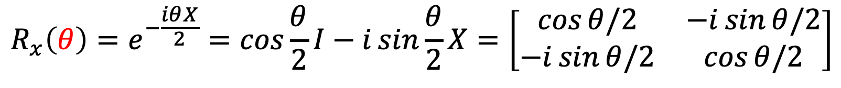

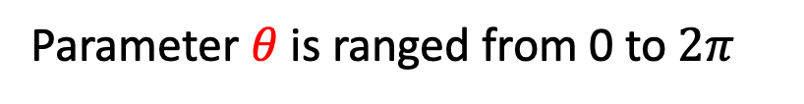
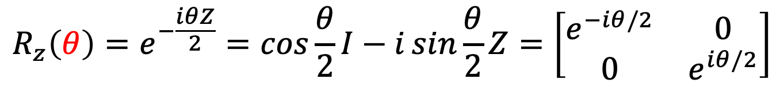
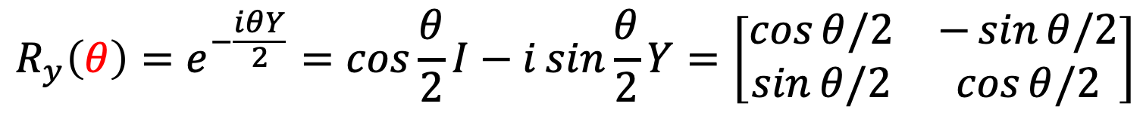
Single qubit gate: Parameterized gate
$$R_{x}\left(θ\right)=e^{−\frac{iθX}{2}}=\cos{\frac{θ}{2}I−i\sin{\frac{θ}{2}}X=\left[\begin{matrix}\cos{θ/2} & −i\sin{θ/2} \\ −i\sin{θ/2} & \cos{θ/2}\end{matrix}\right]}$$
$$R_{y}\left(θ\right)=e^{−\frac{iθY}{2}}=\cos{\frac{θ}{2}I−i\sin{\frac{θ}{2}}Y=\left[\begin{matrix}\cos{θ/2} & −\sin{θ/2} \\ \sin{θ/2} & \cos{θ/2}\end{matrix}\right]}$$
$$R_{z}\left(θ\right)=e^{−\frac{iθZ}{2}}=\cos{\frac{θ}{2}I−i\sin{\frac{θ}{2}}Z=\left[\begin{matrix}e^{−iθ/2} & 0 \\ 0 & e^{iθ/2}\end{matrix}\right]}$$
Parameter $θ$ is ranged from 0 to $2π$
Excercise: Let $x∈ℝ,$ and matrix $A$ such that $A^{2}=I$. Prove:
$$e^{ixA}=\cos{x}I+i\sin{x}A$$

Slide 5
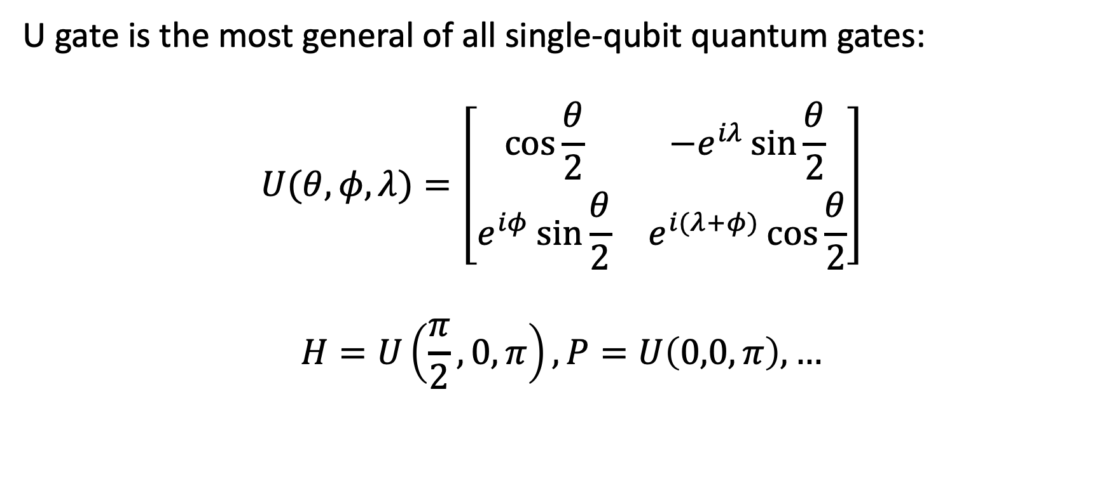
Single qubit gate: universe (U) gate
U gate is the most general of all single-qubit quantum gates:
$$U(θ,φ,λ)=\left[\begin{matrix}cos⁡\frac{θ}{2} & {−e}^{iλ}\sin{\frac{θ}{2}} \\ e^{iφ}\sin{\frac{θ}{2}} & e^{i(λ+φ)}\cos{\frac{θ}{2}}\end{matrix}\right]$$
$$H=U\left(\frac{π}{2},0,π\right),P=U\left(0,0,π\right),…$$

Slide 6



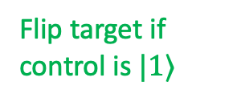
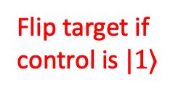
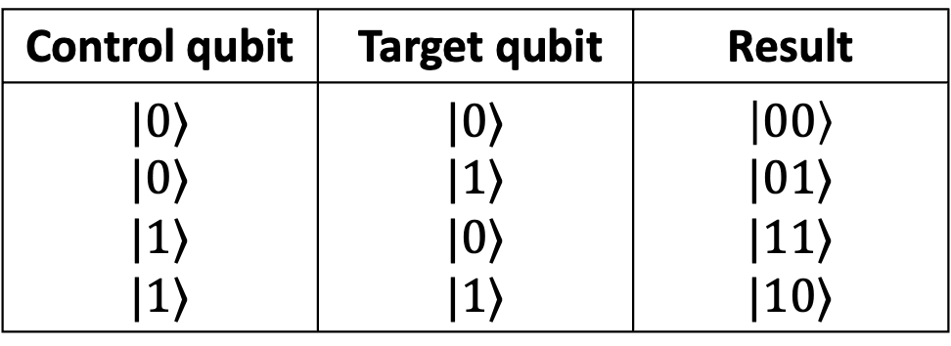
Multi-qubit gate: Control-Not (CX) gate
Control qubit | Target qubit | Result
$$|0⟩$$ $$|0⟩$$ $$|1⟩$$ $$|1⟩$$ | $$|0⟩$$ $$|1⟩$$ $$|0⟩$$ $$|1⟩$$ | $$\left|00\right\rangle$$ $$|01⟩$$ $$|11⟩$$ $$|10⟩$$
$$×$$
Flip target if control is $|1⟩$
$$×$$
Flip target if control is $|1⟩$
1st Control qubit | 2nd Control qubit | Target qubit | Result
? | ? | ? | ?
$$×$$

Slide 7


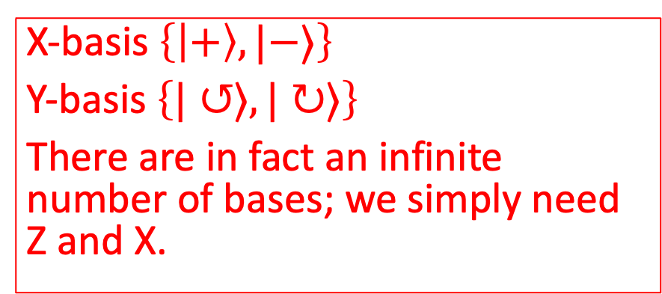


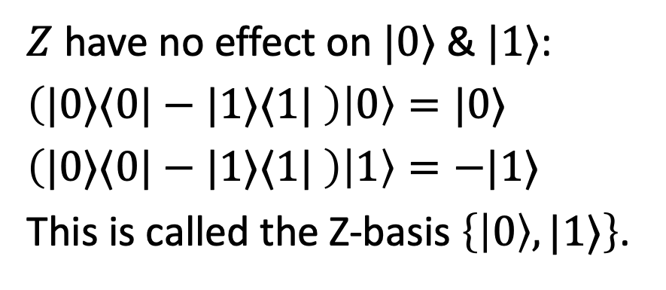







Basis
$$|1⟩$$
$$\left|−\right\rangle$$
$${\left|β\right|}^{2}$$
$Z$ have no effect on $|0⟩$ & $|1⟩$:
$\left(|0⟩⟨0|−|1⟩⟨1| \right)\left|0\right\rangle =|0⟩$
$\left(|0⟩⟨0|−|1⟩⟨1| \right)\left|1\right\rangle =−|1⟩$
This is called the Z-basis $\left\{\left|0\right\rangle ,|1⟩\right\}$.
$${\left|β\right|}^{2}$$
$$|ψ⟩$$
$$|ψ⟩$$
$${\left|α\right|}^{2}$$
$$⇒$$
$$|0⟩$$
X-basis $\left\{\left|+\right\rangle ,|−⟩\right\}$
Y-basis $\left\{|↺⟩,|↻⟩\right\}$
There are in fact an infinite number of bases; we simply need Z and X.
$${\left|α\right|}^{2}$$
$$\left|+\right\rangle$$

Slide 8
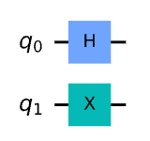
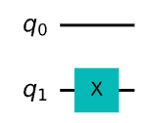

Quantum Circuit
$\left|ψ\right\rangle =H\left|q_{0}\right\rangle ⊗X|q_{1}⟩$
$=\left(H⊗X\right)\left|q_{0}q_{1}\right\rangle =\frac{1}{\sqrt{2}}\left[\begin{matrix}\begin{matrix}0 & 1 \\ 1 & 0\end{matrix} & \begin{matrix}0 & 1 \\ 1 & 0\end{matrix} \\ \begin{matrix}0 & 1 \\ 1 & 0\end{matrix} & \begin{matrix}0 & −1 \\ −1 & 0\end{matrix}\end{matrix}\right]…$
$\left|ψ\right\rangle =I\left|q_{0}\right\rangle ⊗X|q_{1}⟩$

Slide 9

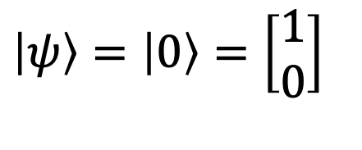

Quantum circuit: single qubit
$\left|ψ\right\rangle =\left|0\right\rangle =\left[\begin{matrix}1 \\ 0\end{matrix}\right]$
$$\left|0\right\rangle$$
$$q_{0}$$

Slide 10
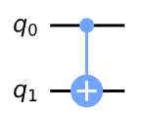

4.1. Circuit
$\left|ψ\right\rangle =CNOT|q_{0}q_{1}⟩$
$=\left[\begin{matrix}\begin{matrix}1 & 0 \\ 0 & 1\end{matrix} & \begin{matrix}0 & 0 \\ 0 & 0\end{matrix} \\ \begin{matrix}0 & 0 \\ 0 & 0\end{matrix} & \begin{matrix}0 & 1 \\ 1 & 0\end{matrix}\end{matrix}\right]…$

Slide 11
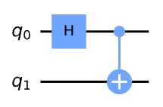
4.1. Circuit
What the output of this circuit?

Slide 12
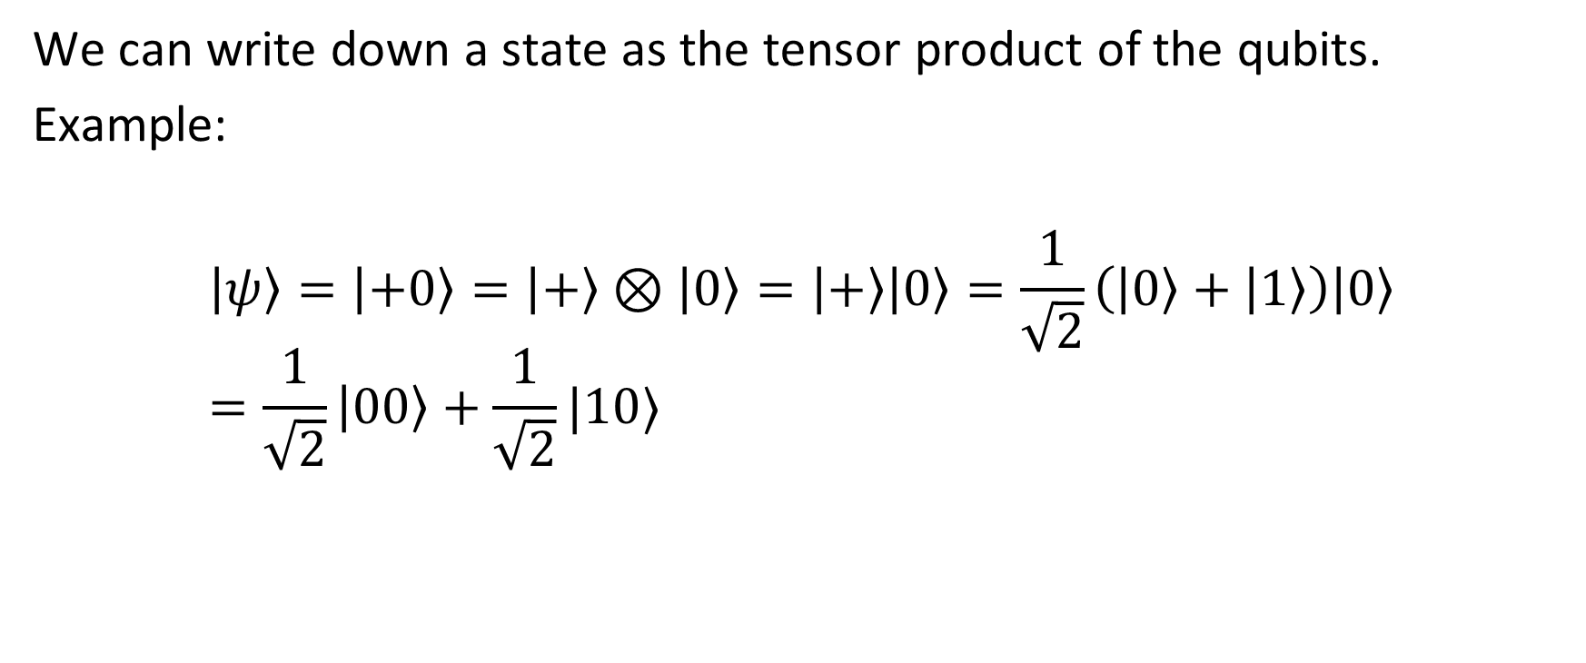
4. Entangled states
We can write down a state as the tensor product of the qubits.
Example:
$$\left|ψ\right\rangle =\left|+0\right\rangle =\left|+\right\rangle ⊗\left|0\right\rangle =\left|+\right\rangle \left|0\right\rangle =\frac{1}{\sqrt{2}}\left(\left|0\right\rangle +\left|1\right\rangle \right)\left|0\right\rangle =\frac{1}{\sqrt{2}}\left|00\right\rangle +\frac{1}{\sqrt{2}}|10⟩$$

Slide 13
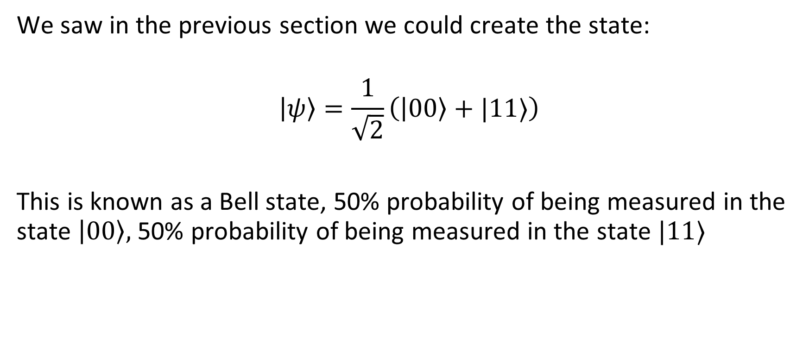
4.2. Entangled States
We saw in the previous section we could create the state:
$$\left|ψ\right\rangle =\frac{1}{\sqrt{2}}\left(\left|00\right\rangle +|11⟩\right)$$
This is known as a Bell state, 50% probability of being measured in the state $\left|00\right\rangle ,$ 50% probability of being measured in the state $|11⟩$

Slide 14
4.2. Entangled state
If we measured the first qubit, what are the value of the second qubit?
It’s also called as “spooky action at a distance” or EPR paradox.

